Slide 1
Analysis of Central Bank Speeches
Employer Project
Scott Brind and Will Fisher

Slide 2
What is the Bank of England?
We’re the UK’s central bank.
Our mission:
Provide ways to pay for things safely
Keep price rises low and stable
Make sure banks are run well
Keep the whole UK financial system stable

Slide 3
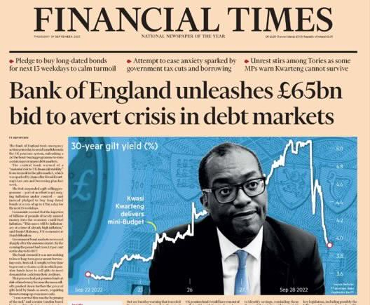
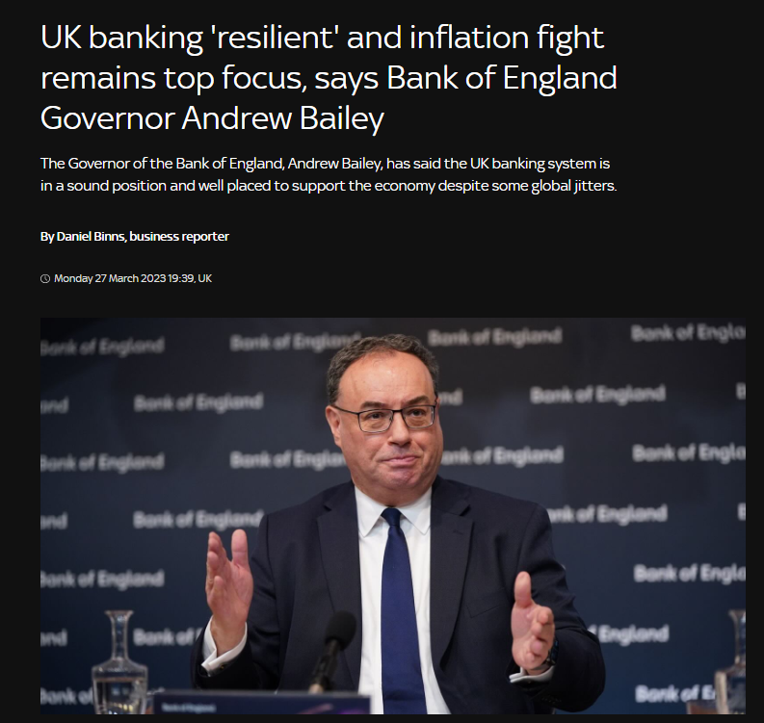
Keeping the whole UK financial system stable
Direct influence
Indirect influence
Source: Financial Times
Source: Sky News

Slide 4
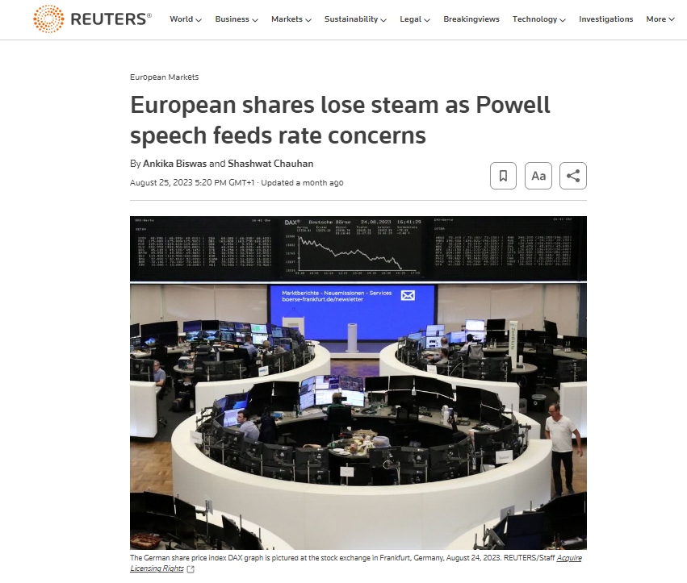
Speeches delivered by central bank representatives can have significant effects on markets
We want to understand these effects better, specifically:
How sentiment has changed over time
How sentiment correlates with other events
How sentiment correlates with economic indicators
Source: Reuters

Slide 5
The data
A dataset containing the content and metadata of BoE speeches in addition to US central bank and EU central bank speeches. This data was collected by a third party and may contain errors you will have to deal with using data cleaning techniques.
A dataset of financial vocabulary and their associated sentiment.
Economic data available on our website (www.bankofengland.co.uk) and the Office for National Statistics (www.ons.gov.uk), including GDP growth, inflation, labour market statistics (eg. unemployment, wages).
Any other relevant data you can find!
Please note: unfortunately we’re not able to share any additional data with you that isn’t already published on our website or in the public domain.

Slide 6
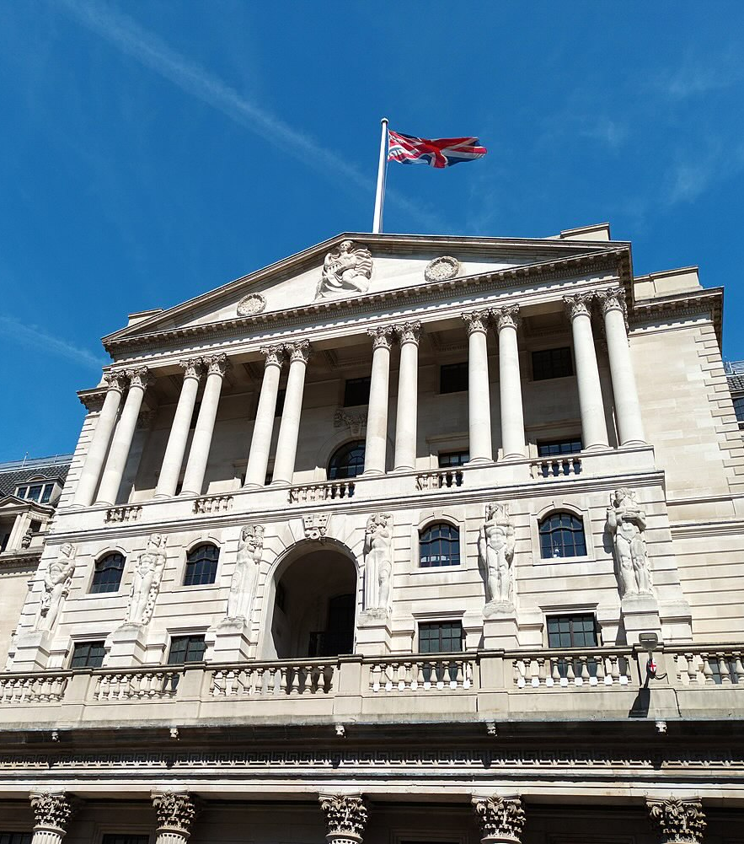
What this project means to us
This project will increase our understanding of our effect on the economy, and help us be more effective in providing stability to the economy.

